Slide 1
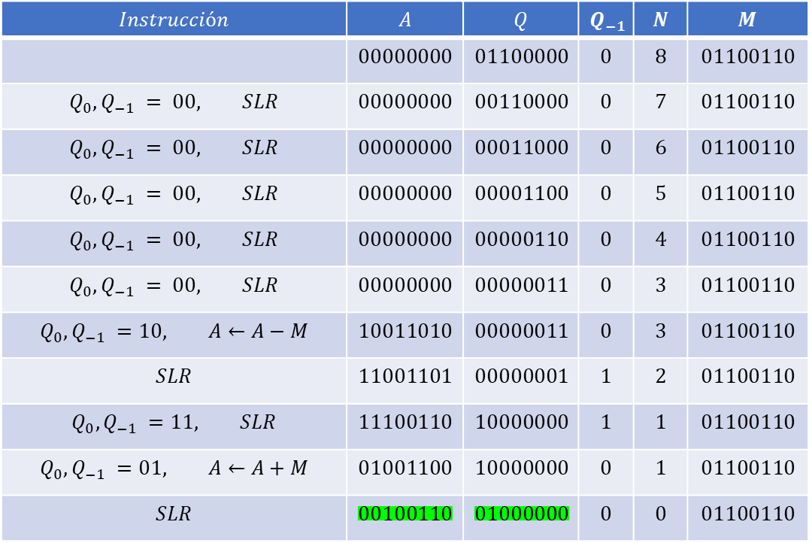
Algoritmo de Booth
$$Instrucción$$ | $$A$$ | $$Q$$ | $$Q_{−1}$$ | $$N$$ | $$M$$
 | $$00000000$$ | $$01100000$$ | $$0$$ | $$8$$ | $$01100110$$
$$Q_{0},Q_{−1} = 00, SLR$$ | $$00000000$$ | $$00110000$$ | $$0$$ | $$7$$ | $$01100110$$
$$Q_{0},Q_{−1} = 00, SLR$$ | $$00000000$$ | $$00011000$$ | $$0$$ | $$6$$ | $$01100110$$
$$Q_{0},Q_{−1} = 00, SLR$$ | $$00000000$$ | $$00001100$$ | $$0$$ | $$5$$ | $$01100110$$
$$Q_{0},Q_{−1} = 00, SLR$$ | $$00000000$$ | $$00000110$$ | $$0$$ | $$4$$ | $$01100110$$
$$Q_{0},Q_{−1} = 00, SLR$$ | $$00000000$$ | $$00000011$$ | $$0$$ | $$3$$ | $$01100110$$
$$Q_{0},Q_{−1} =10, A←A−M$$ | $$10011010$$ | $$00000011$$ | $$0$$ | $$3$$ | $$01100110$$
$$SLR$$ | $$11001101$$ | $$00000001$$ | $$1$$ | $$2$$ | $$01100110$$
$$Q_{0},Q_{−1} =11, SLR$$ | $$11100110$$ | $$10000000$$ | $$1$$ | $$1$$ | $$01100110$$
$$Q_{0},Q_{−1} =01, A←A+M$$ | $$01001100$$ | $$10000000$$ | $$0$$ | $$1$$ | $$01100110$$
$$SLR$$ | $$00100110$$ | $$01000000$$ | $$0$$ | $$0$$ | $$01100110$$

